Slide 1
SDR-Based DDR Air-Gap Data Exfiltration
Exploiting Electromagnetic Side-Channels for Covert Communication
Nikas Ioannis Iason
Tsiantos Dimitrios
Tsogkas Panagiotis Nikolaos

Slide 2
Air-gapped networks
What are they?
Systems physically isolated from unsecured networks such as the internet. They are reserved for high-security environments and the assumption is that since they are physically disconnected from other networks they are virtually immune to remote attacks.
The reality
All electronic devices inherently emit electromagnetic radiation during operation and these emissions can as a side-channel. This project’s goal is to show that data exfiltration is possible with a simple user-space program and no special equipment.

Slide 3
The leaking mechanism
DDR memory
Modern DDR memory buses operate at extremely high speeds, generating significant electromagnetic energy that translate to signals.
Maxwell’s Equations
Memory as an antenna
A time-varying electric current inevitably generates a magnetic field. This means that rapid change in current will produce electromagnetic signals.
By effectively "bit-banging" the memory bus with specific software patterns, we can intentionally shape these emissions into a radio signal.

Slide 4
Setup
Victim Environment
The target is a standard air-gapped workstation where our unprivileged malware exploits the physical memory bus to broadcast signals through the noise of legitimate background processes. This attack requires no hardware modifications or special permissions.
The Channel
We bridge the air gap by modulating memory bus emanations to reach a passive receiver about 1 meter away. Because the receiver emits no radio frequency energy, the interception is completely undetectable by standard counter-surveillance measures.

Slide 5
Challenges
Background noise
Capturing device noise
Distance

Slide 6
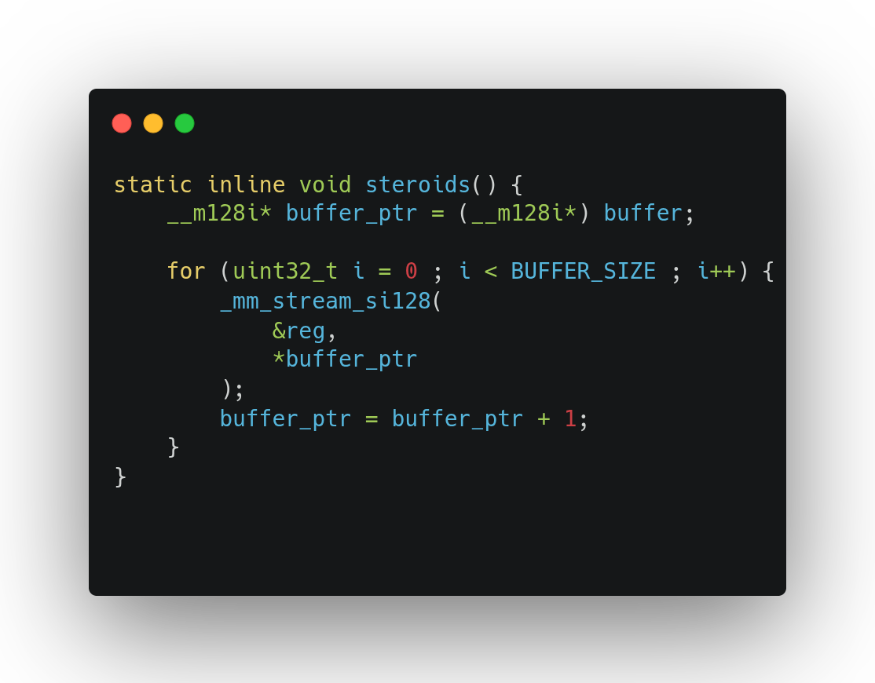
Modulation
Modern CPUs effectively silence the memory bus by trapping data in internal caches, preventing the generation of detectable electromagnetic signals.
We overcome this by using the _mm_stream_si128 intrinsic to execute non-temporal stores, which instructs the CPU to bypass the cache hierarchy entirely.
This forces every write operation directly to the physical DRAM, generating the distinct electromagnetic spikes necessary for our receiver to detect the transmission.

Slide 7

Protocol structure
Preamble: Synchronizes the receiver to the correct bit alignment before the payload begins.
Payload: Arbitrary binary data transmitted sequentially, bit-by-bit (MSB or LSB first depending on implementation).
End of Message (EOM): Signals the receiver to stop recording and flush the buffer.

Slide 8
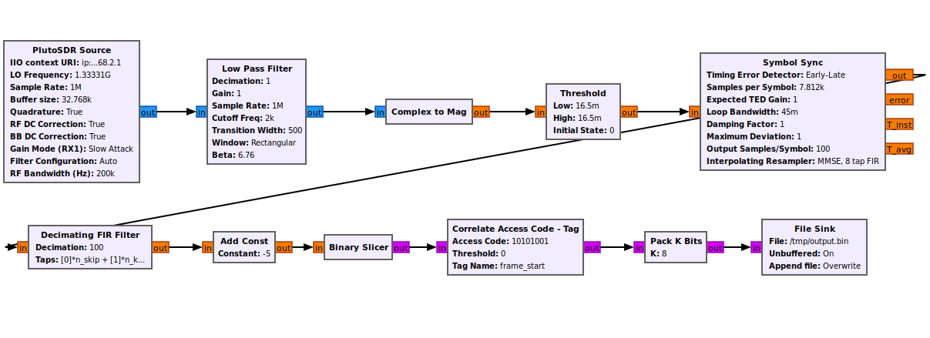
Demodulation

Slide 9
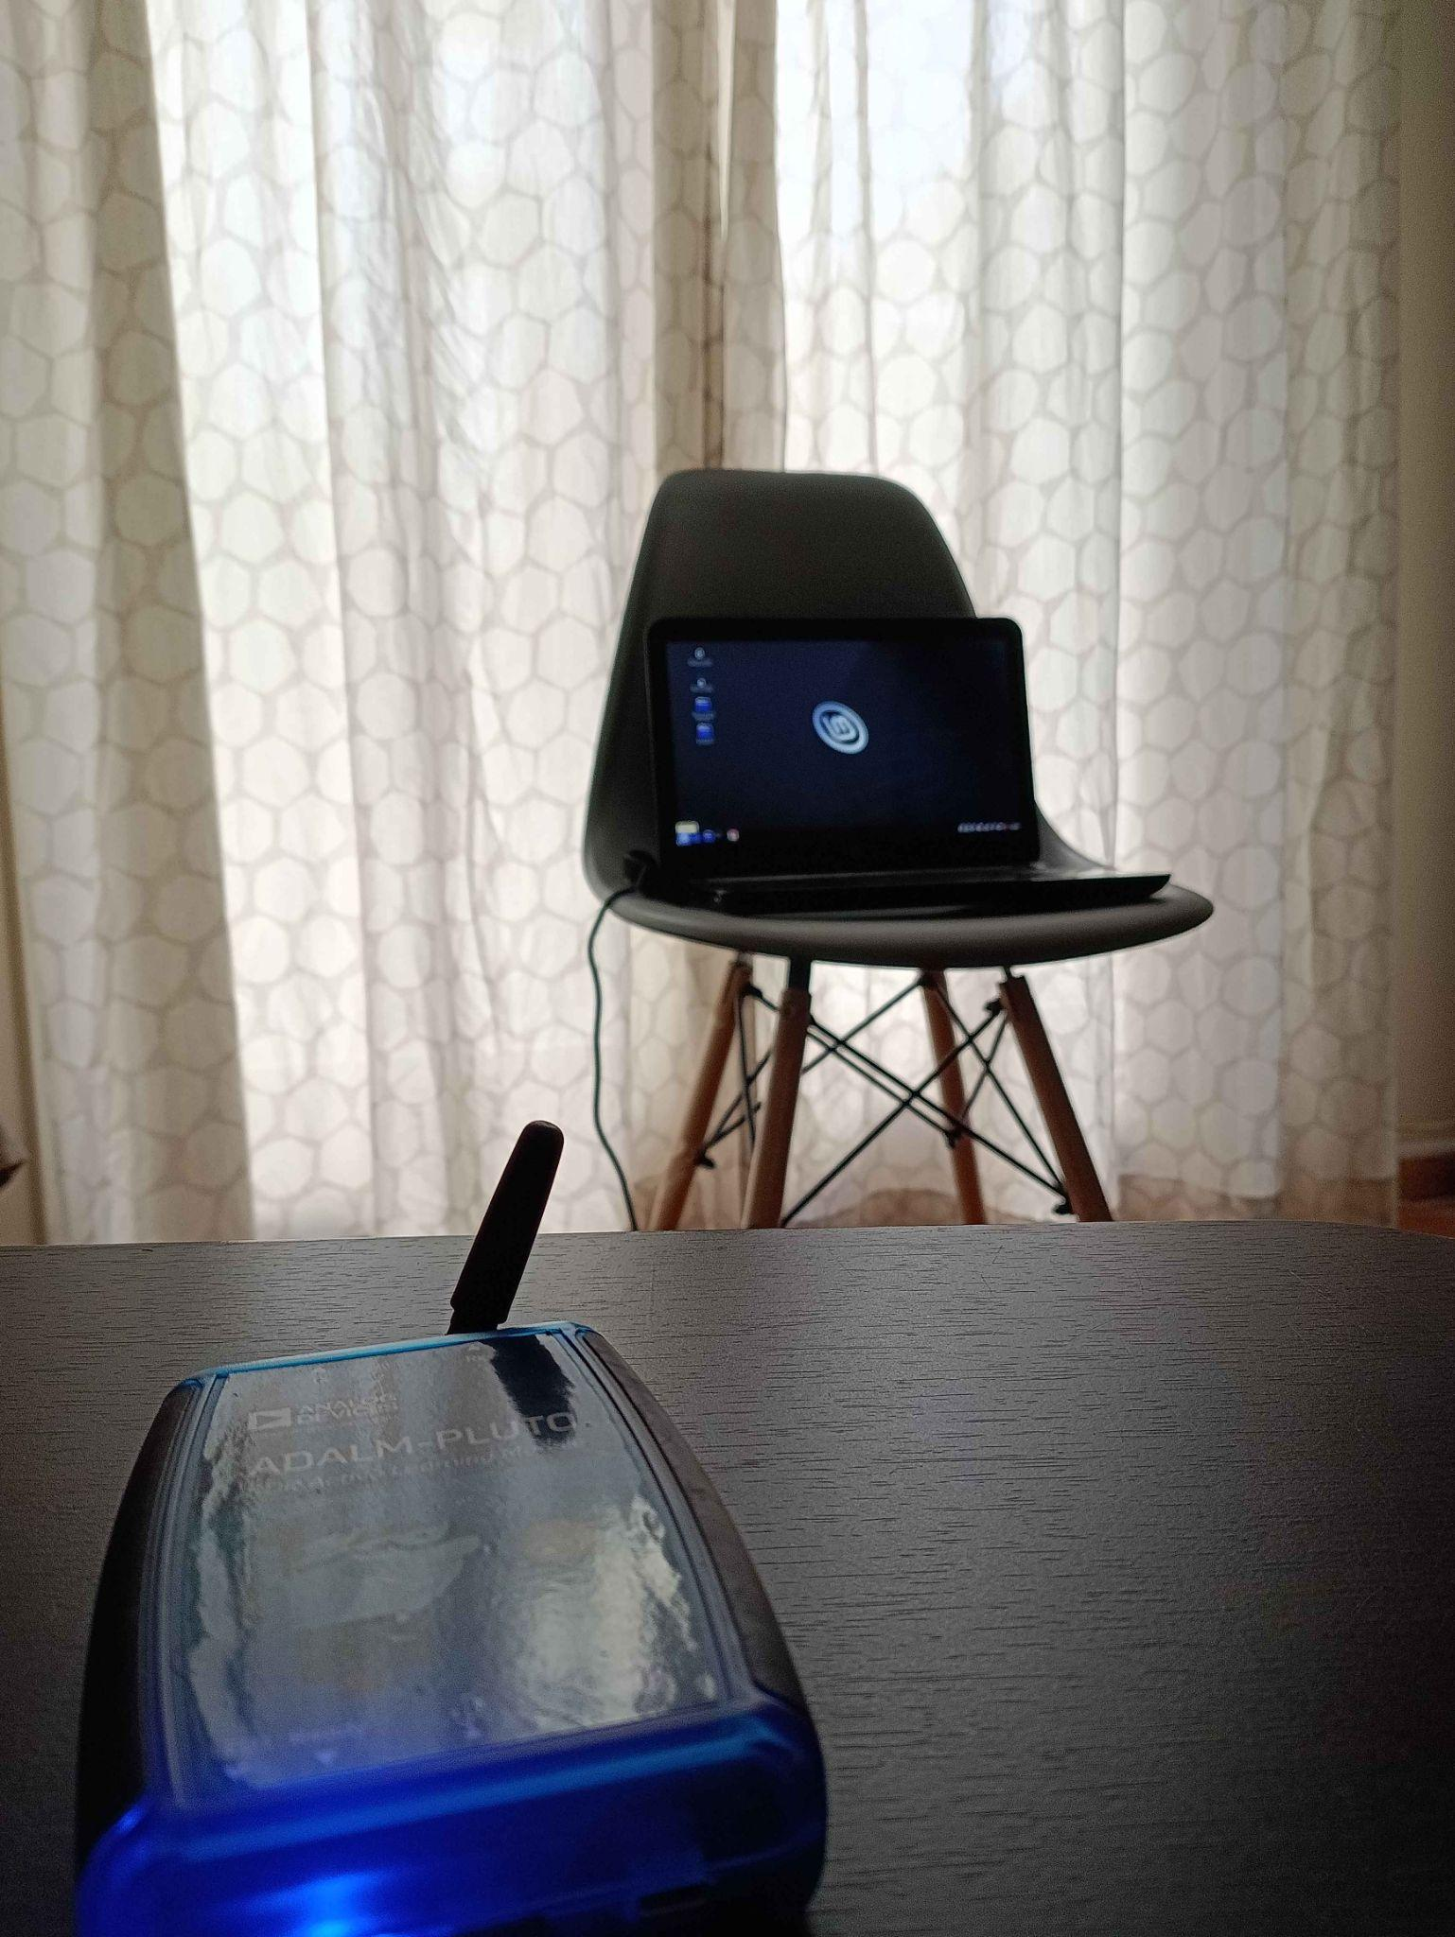

Experimental environment

Slide 10
Transfer times for 128-bit key
Bitrate (bps) | Duration | Delay
4 bps | 32 | 250ms
8 bps | 16 | 125ms
16 bps | 8 | 62.5ms
32 bps | 4 | 31.25ms
64 bps | 2 | 15.625ms
128 bps | 1 | 7.8125ms

Slide 11
Bit Error Rate (BER) %
Bitrate (bps) | 25cm | 50cm | 100cm
4 bps | 0% | 0% | 0%
8 bps | 0% | 0% | 0%
16 bps | 0% | 0% | 0%
32 bps | 0% | 0% | 0%
64 bps | 9.67% | 16.4% | 29.68%
128 bps | 51.2% | failed | failed

Slide 12
Conclusion and Future work
Proof of concept
Our results validate that physical isolation is not a guarantee of security. The physical layer remains a viable attack vector even when the network layer is removed.
Improvements
To improve protocol robustness, we propose using a fixed-length header, ensuring that payloads containing the termination byte do not stop the transmission. Furthermore, we recommend implementing error correction methods to achieve better accuracy.

Slide 13
Thank you!
Nikas Ioannis Iason
Tsiantos Dimitrios
Tsogkas Panagiotis Nikolaos

